Slide 1

Real-Time Rendering
Carl Jones
Week 21: High Dynamic Range (HDR) Lighting

Slide 2
Introduction
Display Range (LDR) = 2⁸
HDR Lighting = 2³²
Use tone mapping to map from HDR to LDR for display

Slide 3
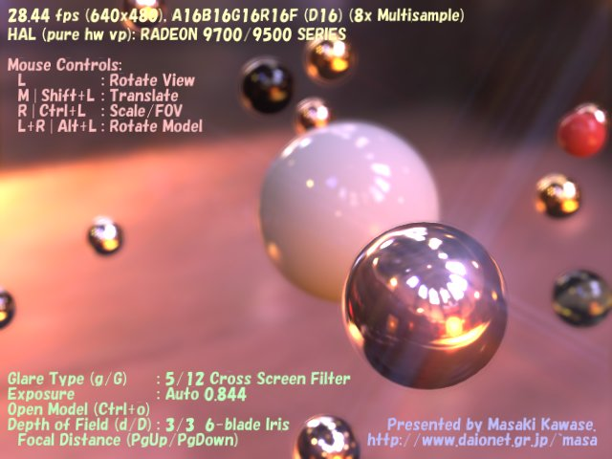
Real Time HDR Lighting
Kawase, Masaki. "Real-Time High Dynamic Range Image-Based Lighting".

Slide 4
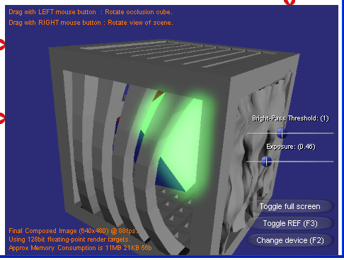
Render to a HDR texture

Slide 5
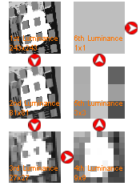
Computing the average luminance

Slide 6
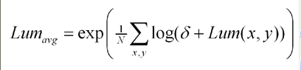
Calculate Average Scene Luminance
Delta is a small number > 0

Slide 7
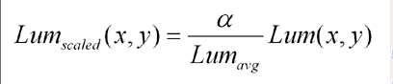
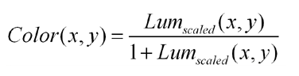
Correct Exposure - Tone Mapping
Compress HDR image into LDR Display
Alpha is the target average luminance

Slide 8
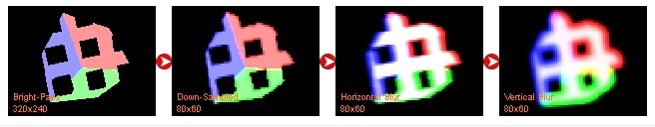
Post Processing (Glow)

Slide 9
Final LDR Display
Scale colour values and overlay glow

Slide 10
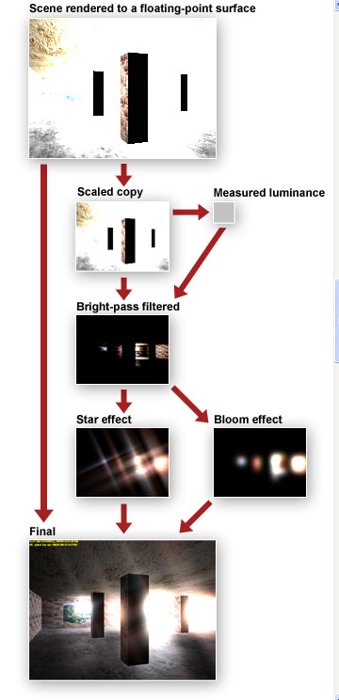
Summary

Slide 11
If HDR Textures are unavailable
decoded.rgb = encoded.rgb * 2^encoded.a
RGBE8 encoding using the alpha channel

Slide 12
FURTHER READING
HDRLighting Sample – DirectX SDK(2007)
Kawase, Masaki. "Real-Time High Dynamic Range Image-Based Lighting".
Reinhard, Erik, Mike Stark, Peter Shirley, and James Ferwerda. "Photographic Tone Reproduction for Digital Images". ACM Transactions on Graphics (TOG), Proceedings of the 29th Annual Conference on Computer Graphics and Interactive Techniques (SIGGRAPH), pp. 267-276. New York, NY: ACM Press, 2002.

